Slide 1
§9-5 Tangents
Definitions
  Secant
  Tangent
A secant is a _____ that passes through a circle, intersecting the circle _______.
A tangent is a ____ that passes through a circle, intersecting the circle ___________.
The point where the line intersects the circle is called the ____________________.

Slide 2
More Definitions
Definitions
  Tangent Circles
Two circles are tangent if they _______________________.

Slide 3
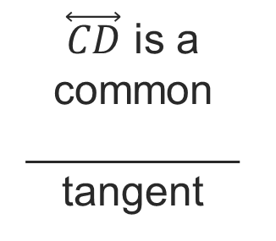

More Definitions
$\overset{⃡}{CD}$ is a common _________ tangent
Definitions
  Tangent Circles
  Common Tangent
    Internal
    External
Common internal tangents are ____________ the two circles.
$\overset{⃡}{BF}$ is an common _________tangent
Common external tangents are _________ the two circles.

Slide 4
Theorems
If a line is tangent to a circle, then it is ______________ to the ________ drawn to the ________________.
P
l
Q

Slide 5
Theorems
In a plane, if a line is _____________ to a _________ of a circle at its endpoint on the circle, then the line is ________ to the circle.
P
l
Q

Slide 6
Theorems
Theorem
  If two segments from the _______________ are __________ to a circle, then they are ________.

Slide 7
Example 1. Find the value of x.

Slide 8
Example 2. Find the value of x.

Slide 9
Your Turn:
Find the values of x, y, and z in the diagram.

Slide 10
Your Turn:
Find the values of x, y, and z in the diagram.

Slide 11
Your Turn:
Find the values of x, y, and z in the diagram.

Slide 12
Prove it!
Given:
Prove:

